Slide 1
Gliocas
WAD2 project design specification

Slide 2
overview
Glas Overgow is a web application aimed to work as a forum for Glasgow university students where they will be able to post questions and discuss university assignments. A user can sign up, specify which degree he is studying and which year so that only the relevant forums would be displayed to him. Then if he has a question about any assignment he can post a question on the forum to which other users can respond. Or he can respond to an already existing question or respond to comments on the question. Every post and comment can be liked/ disliked by users and if a comment answers the users question, the user can mark that comment as an answer and can close the thread.

Slide 3

User persona 1(Amy)
Amy is a 22 year old Mathematics student currently studying 4th year Maths. She understands the course well and is thinking of getting a PhD. She enjoys solving challenging Maths problems and helping others. However ever since she was a kid she was very shy She’d like to help her fellow students that are struggling wherever she can but is too shy to do it in person and other platforms don’t offer any convenient solutions.

Slide 4

User persona 2(Johnny)
Johnny is a 19 year old fresher who enjoys getting drunk and partying. Since he likes to party so much he has little time left for any studies and as such is struggling with most of his coursework. He relies on WolframAlpha and StackOverflow to solve all his problems, however he finds that some of them are too specific and most of them don’t actually make an effort to teach him the knowledge necessary to perform well on the exams.

Slide 5

User persona 3(Alex)
Alex is a 20 year old student who currently studies 2nd year Gender Studies. He is a good student but sometimes he does not understand some concepts. However, he is usually too intimidated by lecturers, so he prefers to ask his fellow peers, but he would like a way of knowing which answer is considered the most reliable, so he does not get wrong information.

Slide 6
specification
The intended users for the app are students studying at a single university. As for the purpose of the site, it’s to allow students to ask their fellow students for help with assignments and for other students to help them.
People struggling with a course or other things will be able to ask their peers questions and others will be able to try and explain the material.
Volunteers who are confident with the course material will provide the people struggling with help and advice and depending on if it’s correct receive “props” as a thanks for the answers which are then displayed on their profile.
Lecturers will be able to see what topics people are having the most trouble with.
Users should be able to:
make an account
ask questions
write in mathematical formulas
answer questions
attach images to answers and questions
reply and discuss answers
search for questions based on criteria
rate comments based on their correctness
the questions should be categorised by course and more widely by subject

Slide 7
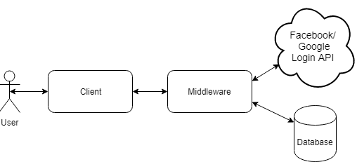
System architecture diagram

Slide 8
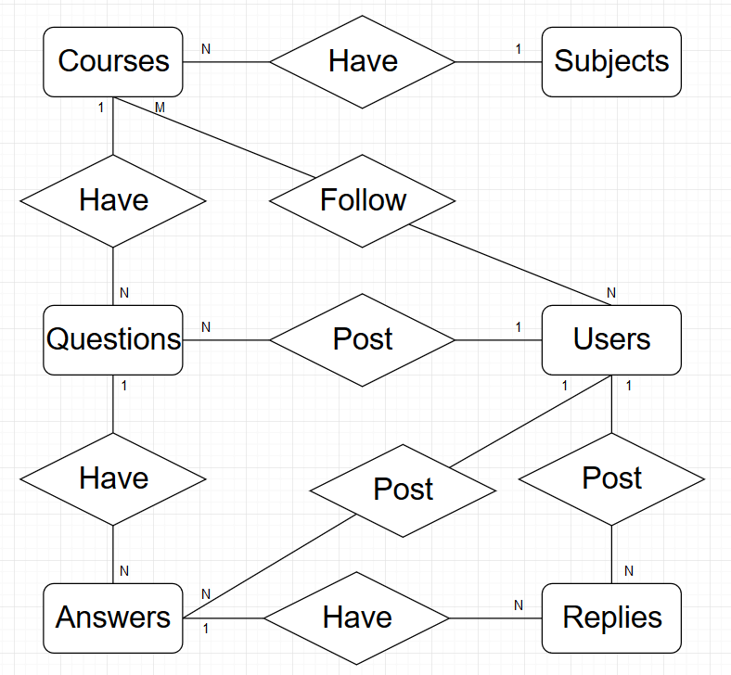
ER diagram

Slide 9
users
Users
Field | Type
Username | Char (128) (Primary key)
Email address | Char (128) (formatted) (Unique)
Password | Char (128)
URL | Slug

Slide 10
subjects
Subjects
Field | Type
Name | Char (64) (Primary key)
URL | Slug

Slide 11
courses
Courses
Field | Type
Name | Char (64) (Primary key)
Parent subject | Char (64) (Foreign key)
URL | Slug

Slide 12
questions
Questions
Field | Type
Course | Char (64) (Foreign key)
Question number | Int (autogenerated) (Primary key)
Question title | Char (256)
Question text | Char (32768)
Upvote count | Int
Date | Datetime
Views | Int
Original poster | Char (128) (Foreign key)
URL | Slug

Slide 13
answers
Answers
Field | Type
Comment number | Int (autogenerated) (Primary key)
Question number | Int (Foreign key)
Poster | Char (128) (Foreign key)
Answer text | Char (32768)
Date | Datetime
Upvote count | Int

Slide 14
replies
Answers
Field | Type
Comment number | Int (autogenerated) (Primary key)
Question number | Int (Foreign key)
Poster | Char (128) (Foreign key)
Answer text | Char (32768)
Date | Datetime
Upvote count | Int

Slide 15
Followed courses
Followed Courses
Field | Type
Course name | Char (64) (Foreign key)
Username | Char (128) (Foreign key)

Slide 16
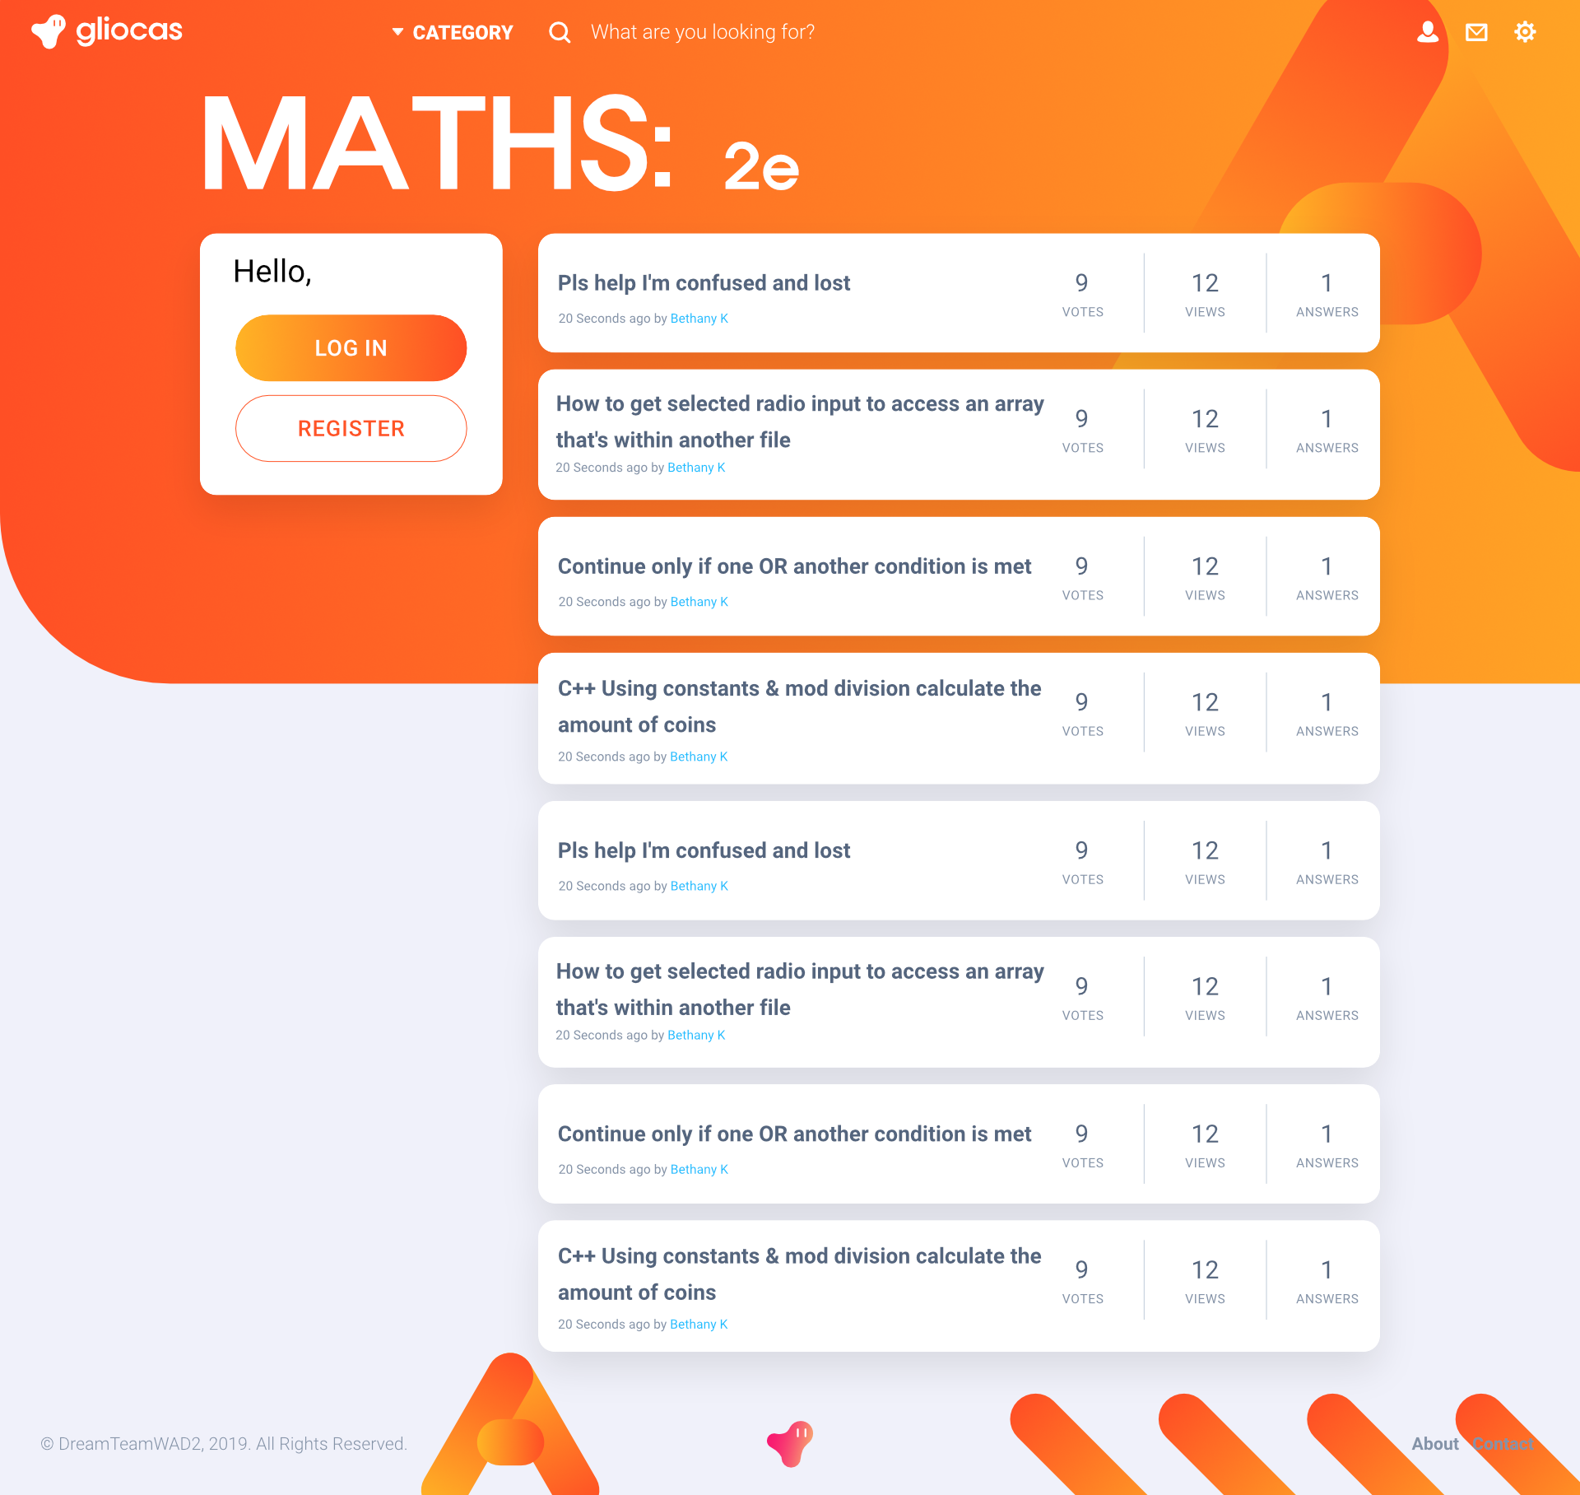
wireframes

Slide 17
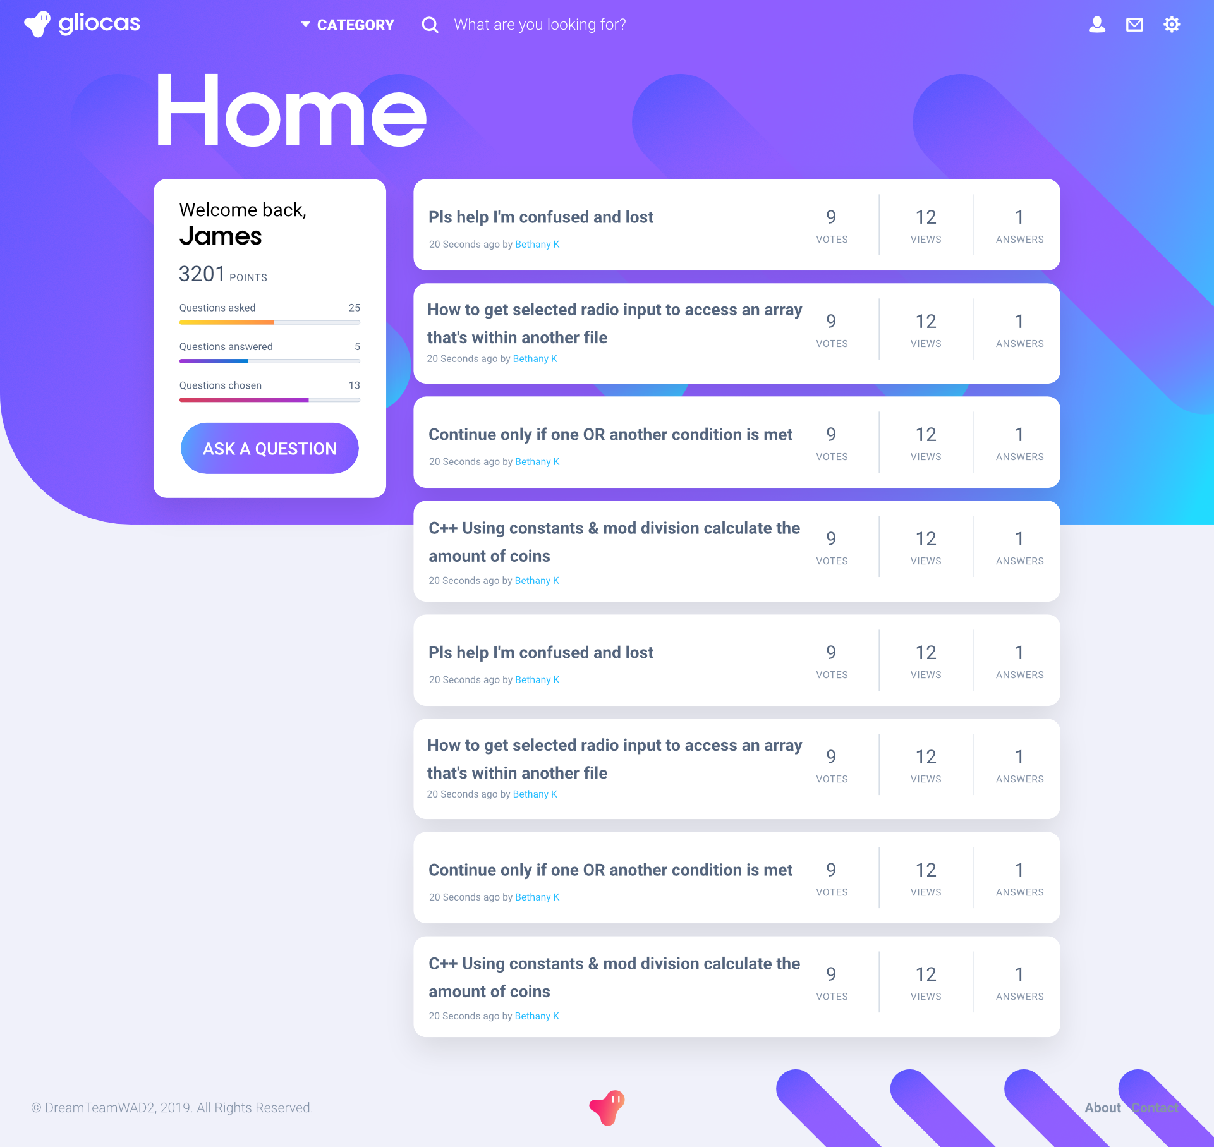

Slide 18
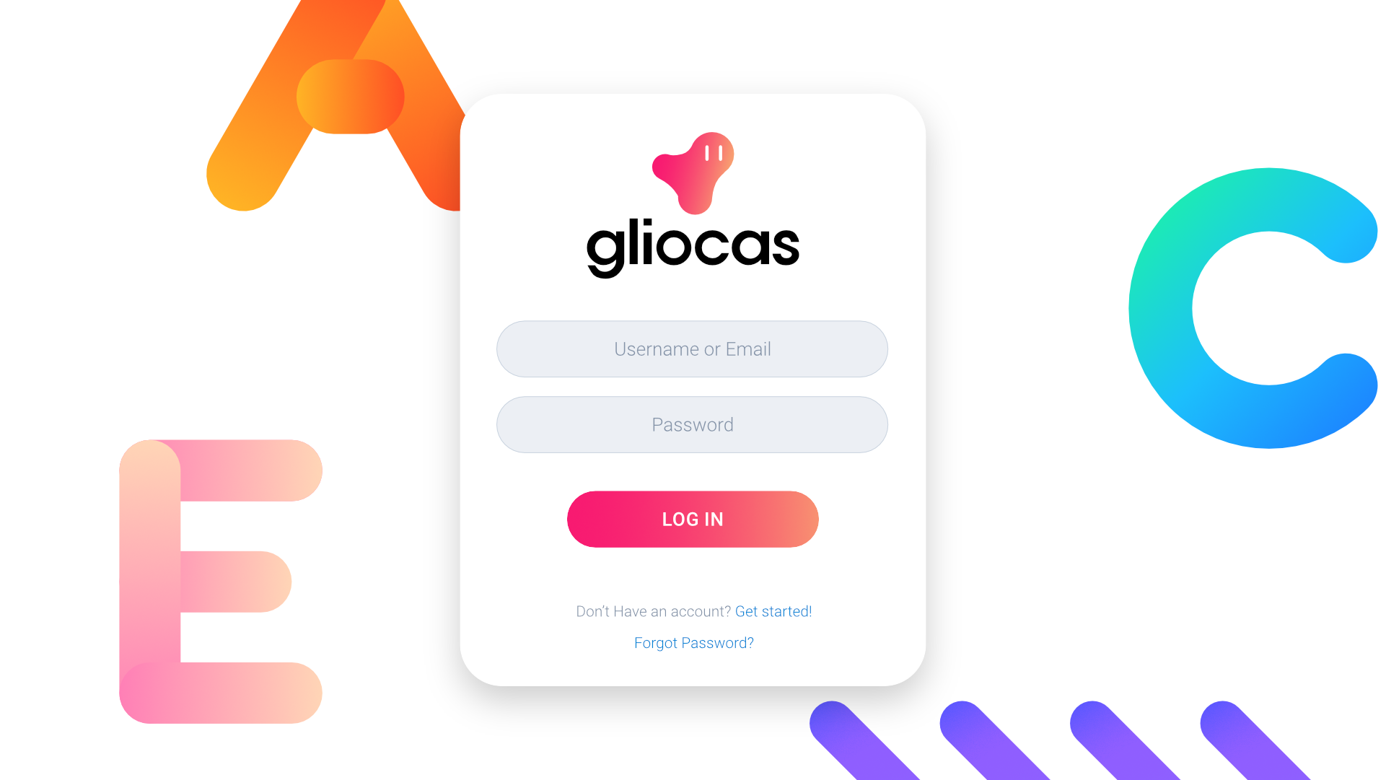

Slide 19
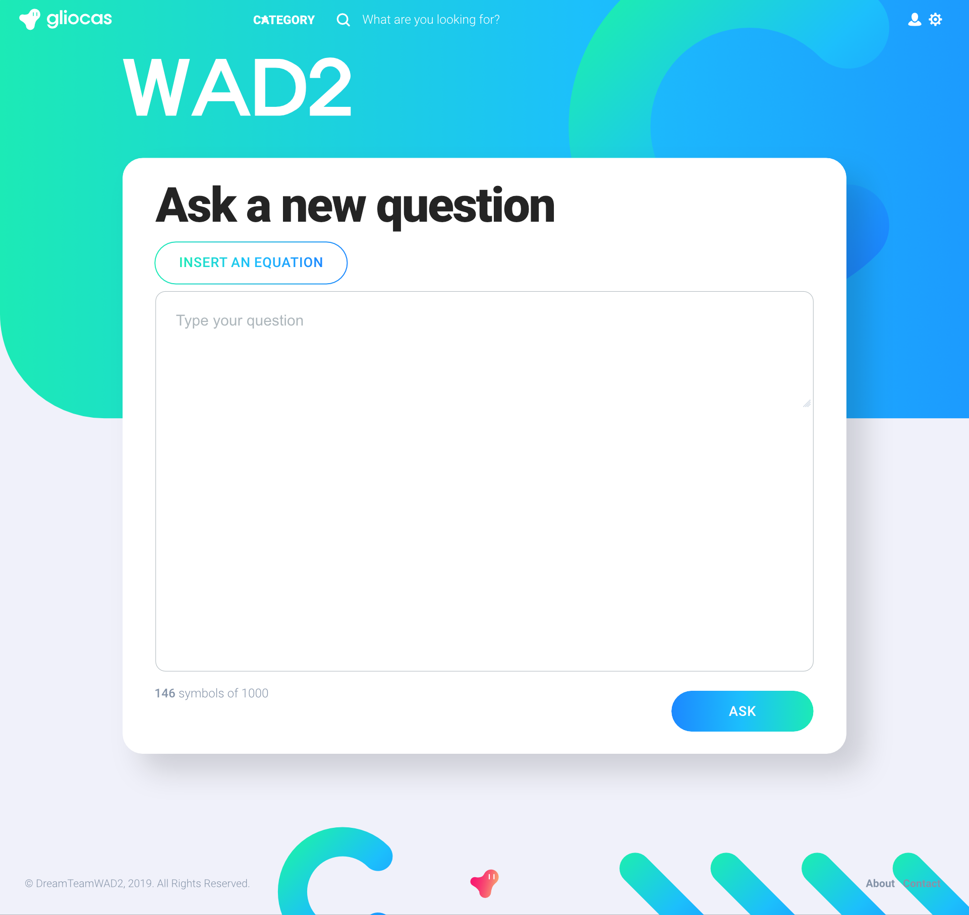

Slide 20
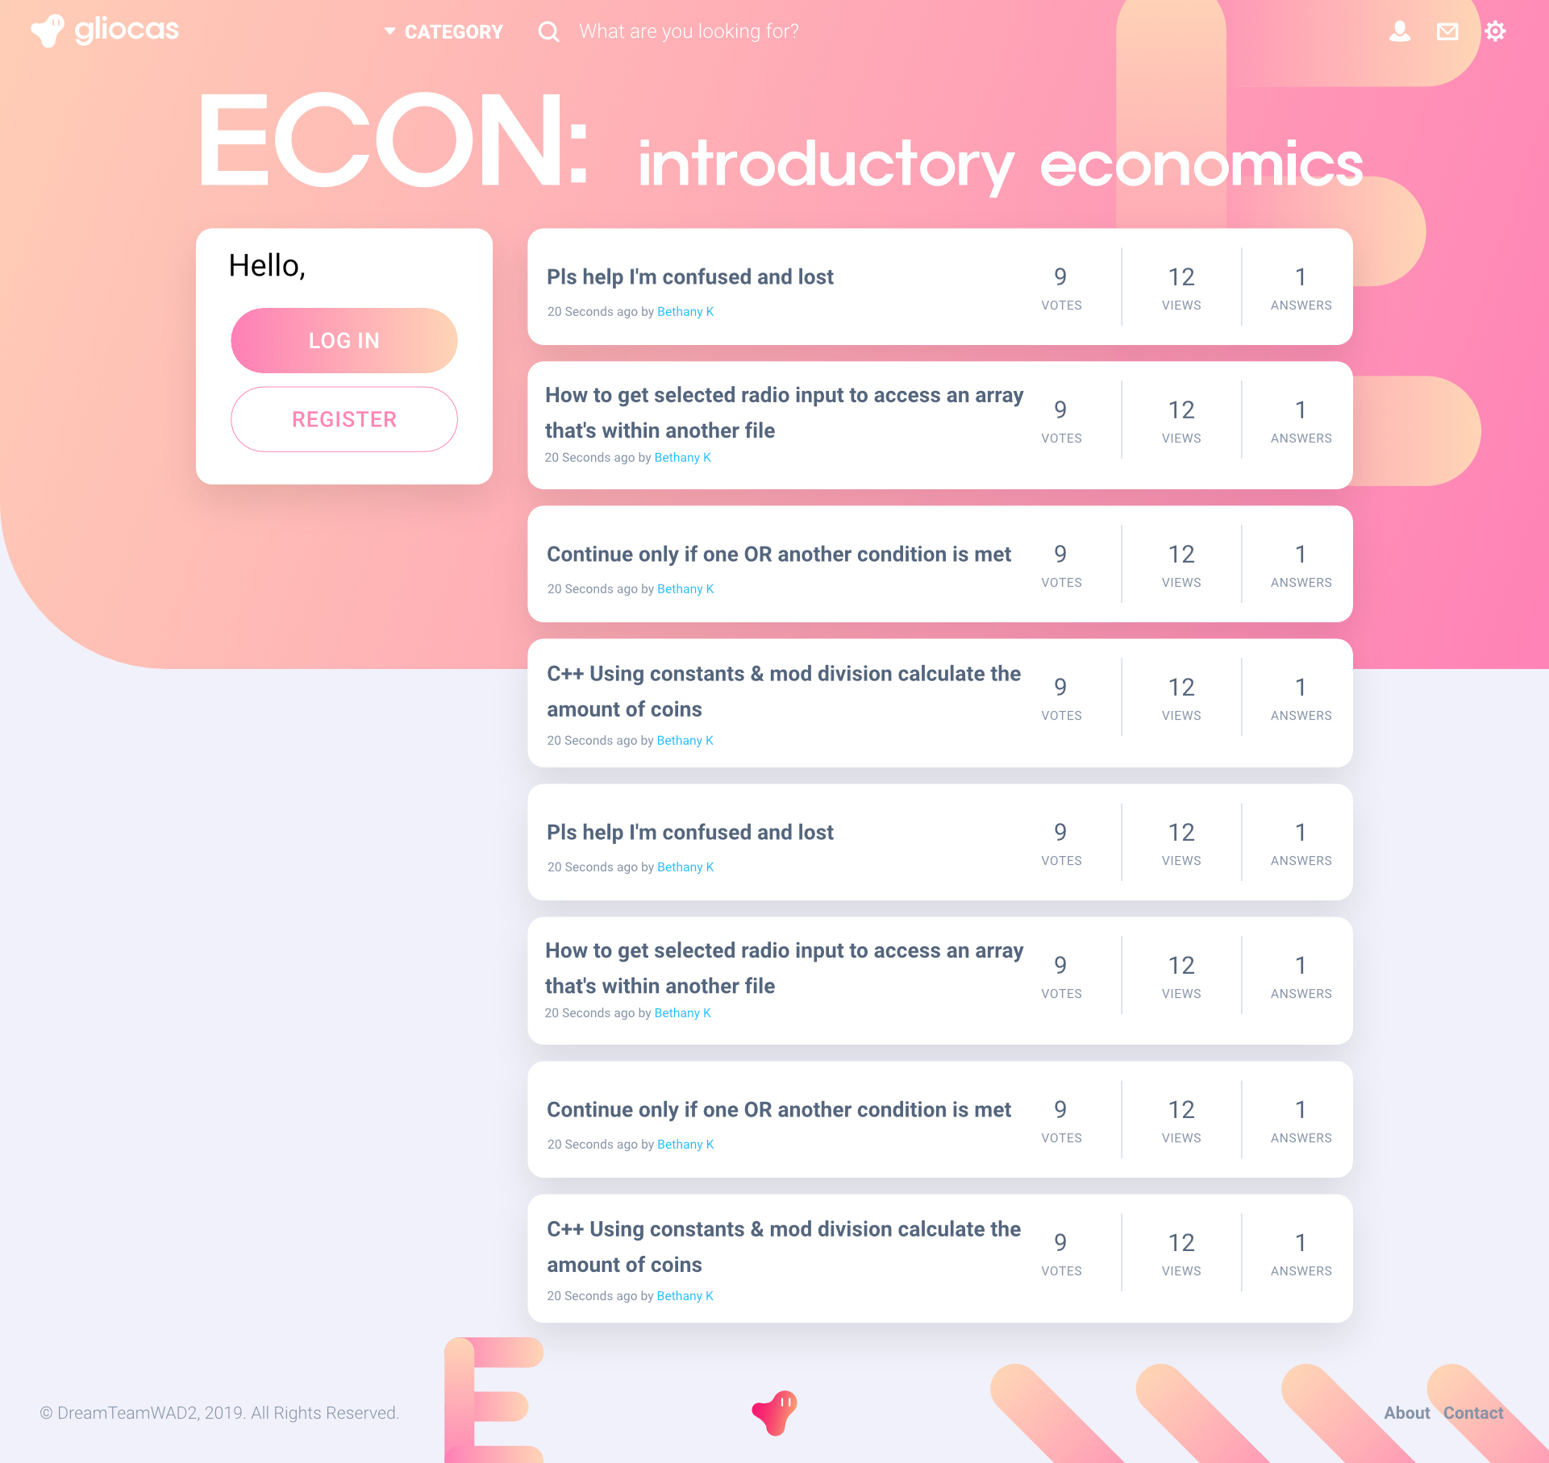

Slide 21
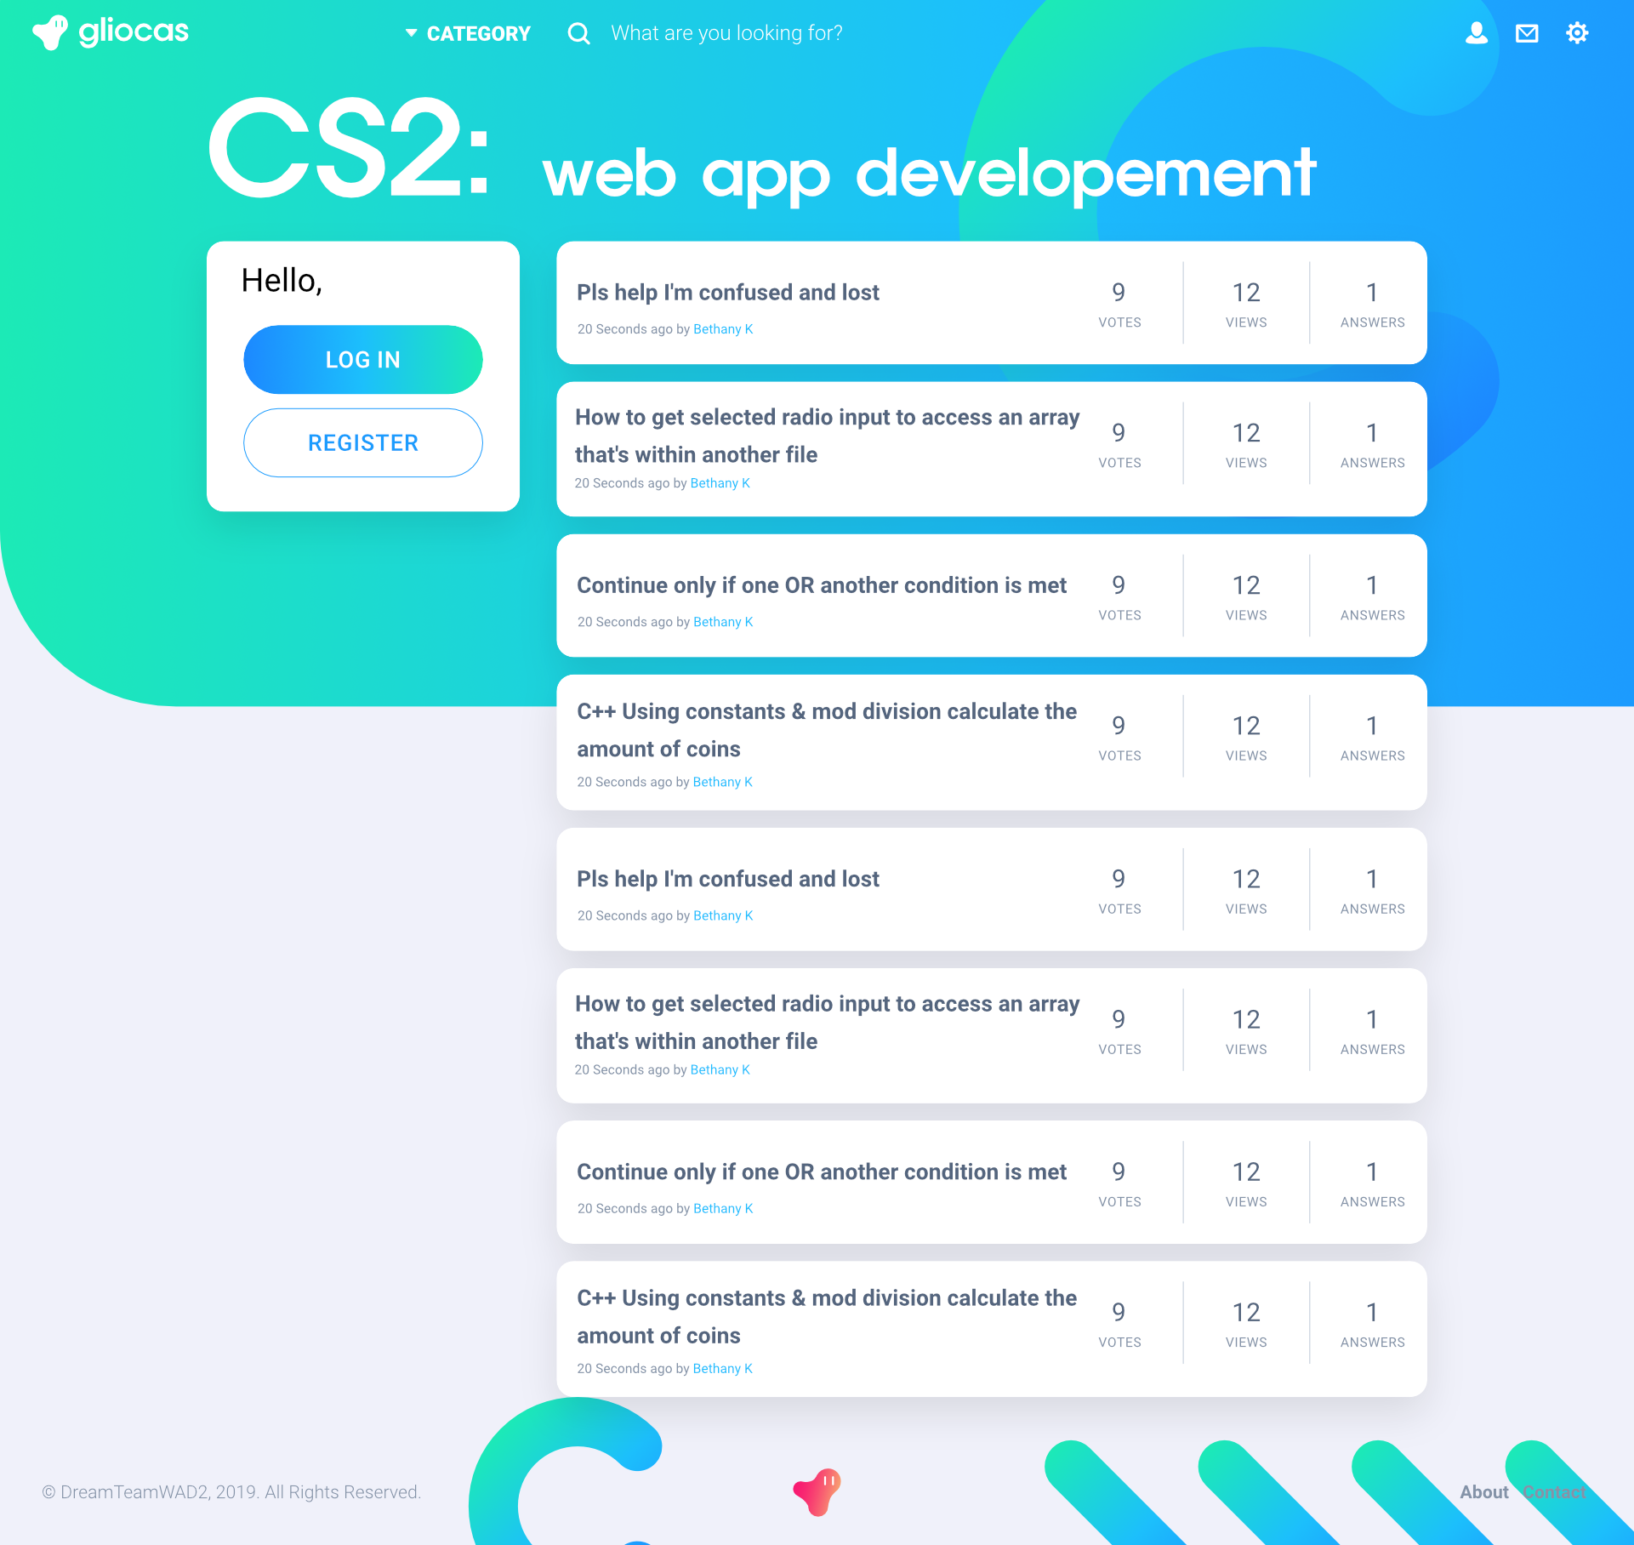

Slide 22
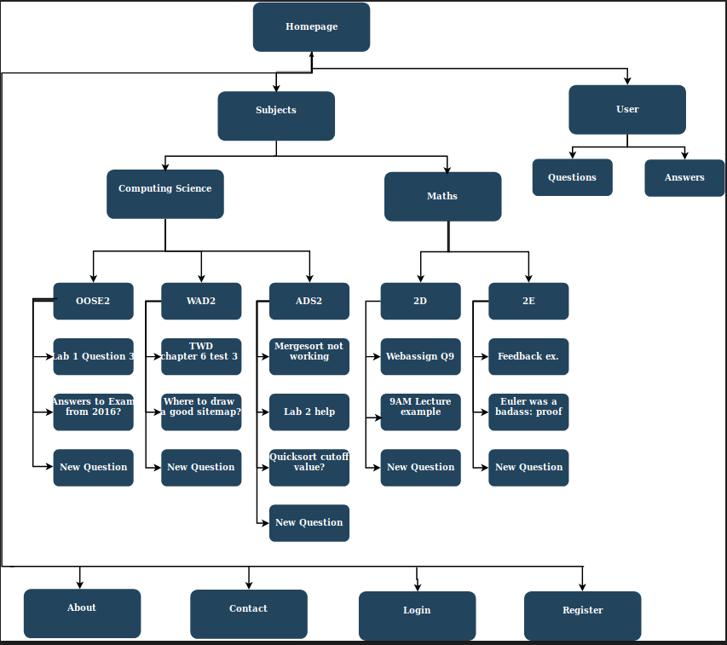
walkthrough
/home
/about
/contact
/subjects/
/subject/courses/
/subject/<course>/
/subject/<course>/question
/subject/<course>/new-question
/user/<user-name>
/user/answers/
/user/questions/
/login
/register

